Slide 1

Futurense
Democratizing Tech Talent to deliver impact at scale
© 2023 Futurense Technologies Private Limited. All rights reserved.

Slide 2
HealthCare – Complex Reporting
[MySQL Project]
NIKUNJ PATHAK (FT780)
FF23
© 2023 Futurense Technologies Private Limited. All rights reserved.

Slide 3

Index:
Overview
Tools and Technologies Used
Headline Statistics
Database’s ER diagram
Implementation Screenshots/Code Snippets
Highlights
Optimizations and Best Practices Used
Roadblocks & Resolutions
Future Scope
© 2023 Futurense Technologies Private Limited. All rights reserved.

Slide 4
Overview:
A basic SQL project that demands creation of different reports from different stakeholders from healthcare domain.
Using SQL creation of several reports.
© 2023 Futurense Technologies Private Limited. All rights reserved.

Slide 5


Tools and Technologies Used:
© 2023 Futurense Technologies Private Limited. All rights reserved.

Slide 6
Headline Statistics (1/2):
Average execution time of a query 34ms
825 Lines of Code
Total number of functions – 17
Number of built-in functions used – 13
Number of user-defined functions used – 4
Avg. number of lines per function - 11
© 2023 Futurense Technologies Private Limited. All rights reserved.

Slide 7
Headline Statistics (2/2):
Number of comments written - 55
IDE/Code Editor Used – DBEAVER
© 2023 Futurense Technologies Private Limited. All rights reserved.

Slide 8
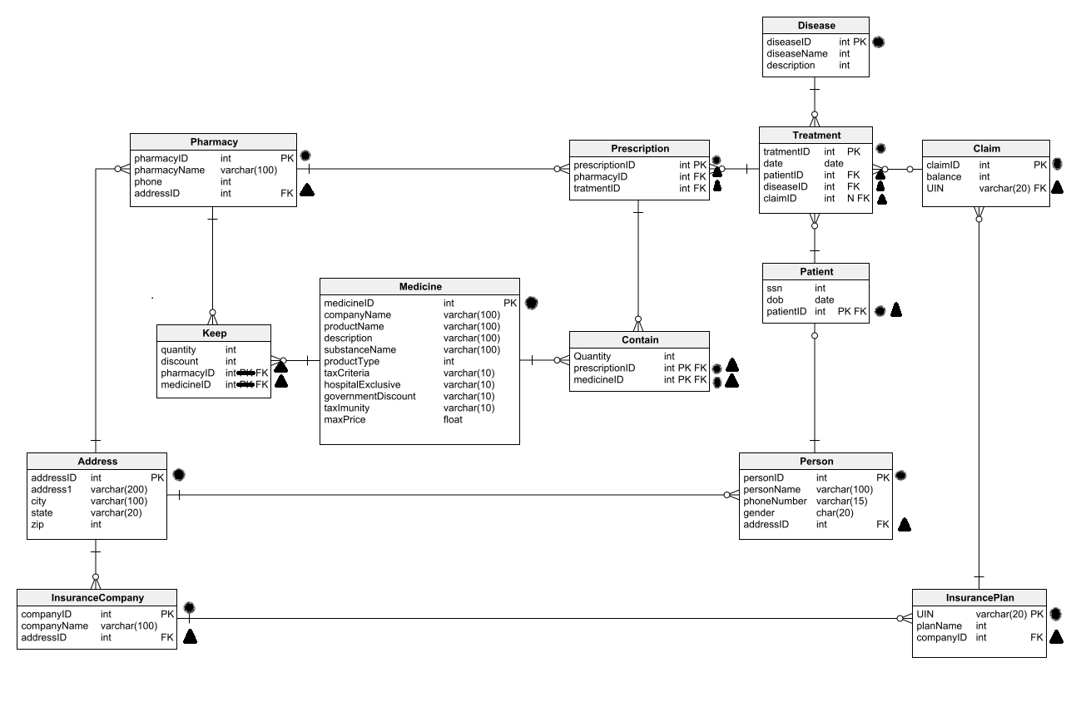
Database’s ER diagram:
© 2023 Futurense Technologies Private Limited. All rights reserved.

Slide 9
Implementation Screenshots/Code Snippets

Slide 10
Q. male-to-female ratio for each disease.

Slide 11
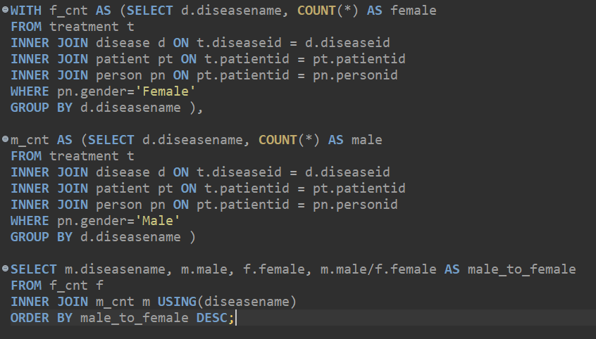
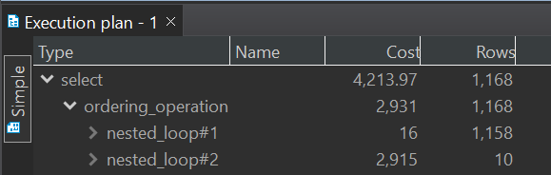
Approach 1
Average Duration: 31ms
© 2023 Futurense Technologies Private Limited. All rights reserved.

Slide 12
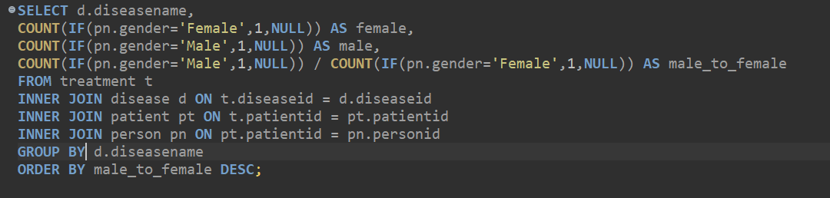
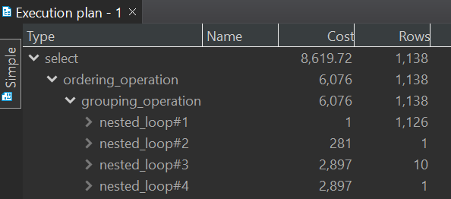
Approach 2
Average Duration: 80ms
© 2023 Futurense Technologies Private Limited. All rights reserved.

Slide 13
Q. Most and least claimed insurance plan for
each disease.

Slide 14
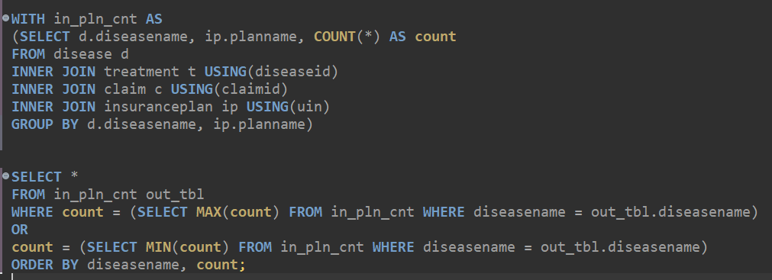
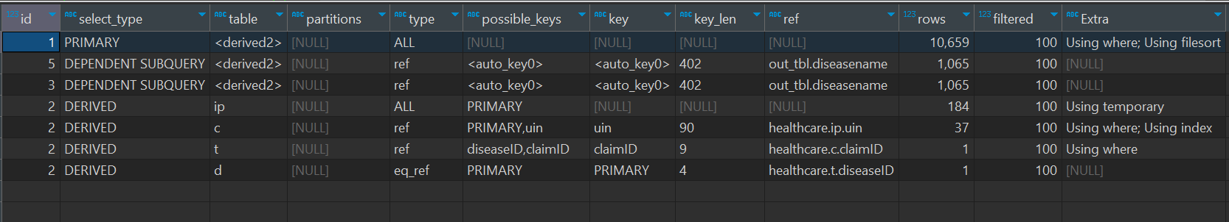
Approach 1
Average Duration: 243ms
© 2023 Futurense Technologies Private Limited. All rights reserved.

Slide 15
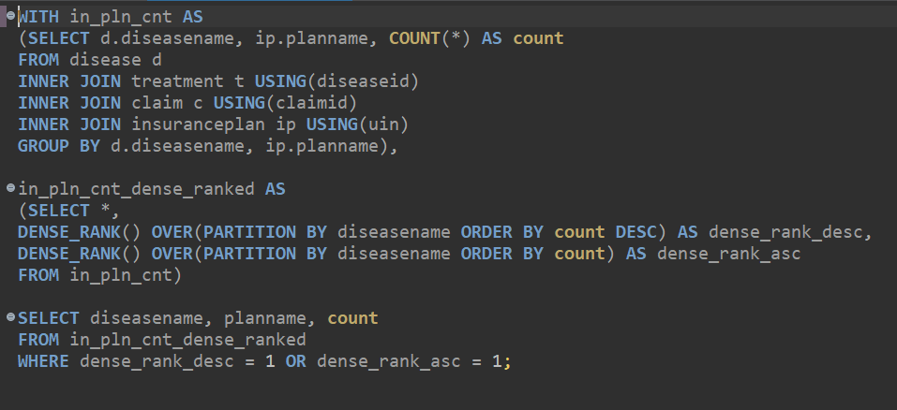
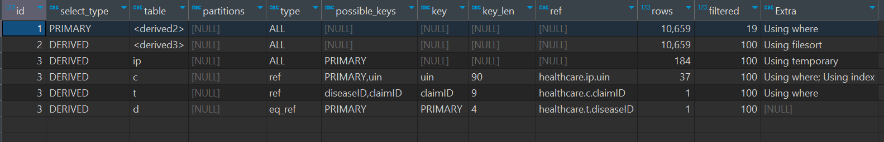
Approach 2
Average Duration: 120ms
© 2023 Futurense Technologies Private Limited. All rights reserved.

Slide 16
Q. No. of male & female that underwent
treatment in 2022 for each disease.

Slide 17
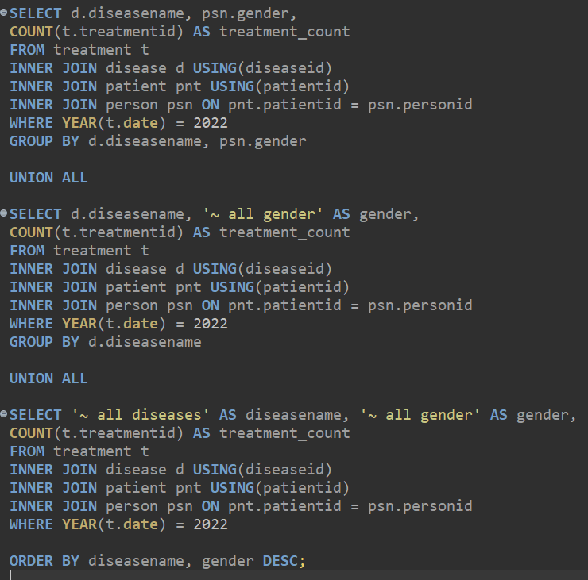
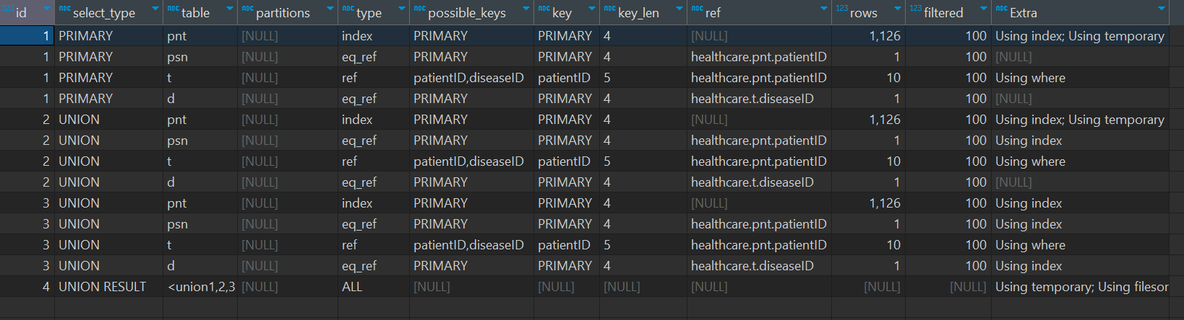
Approach 1 (WITHOUT ROLLUP)
Average Duration: 100ms
© 2023 Futurense Technologies Private Limited. All rights reserved.

Slide 18
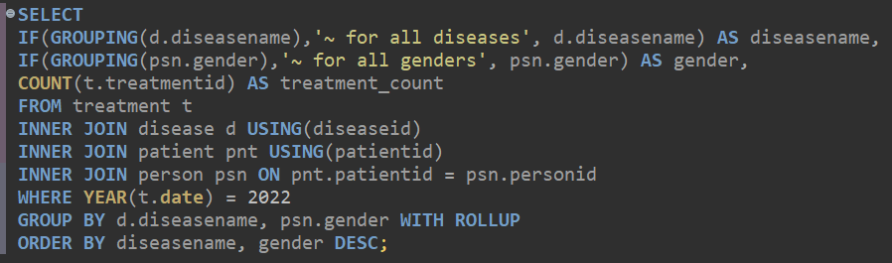
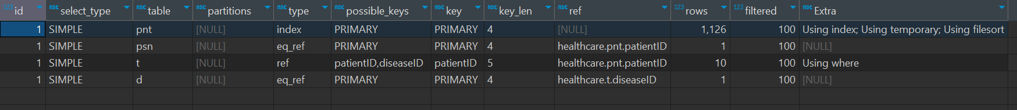
Approach 2 (WITH ROLLUP)
Average Duration: 45ms
© 2023 Futurense Technologies Private Limited. All rights reserved.

Slide 19
Q. Function to determine the most spread
disease in a given state for a given
year.

Slide 20
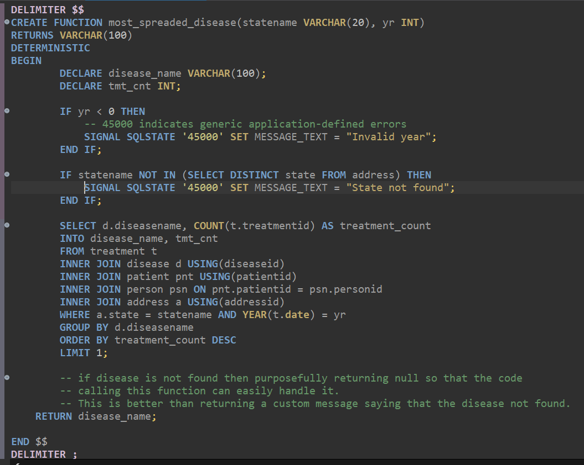
© 2023 Futurense Technologies Private Limited. All rights reserved.

Slide 21
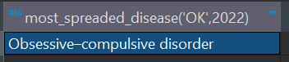


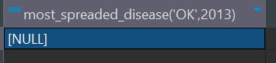
OUTPUT

Slide 22
Q. Create a system that automatically records
any update in the Keep table.

Slide 23
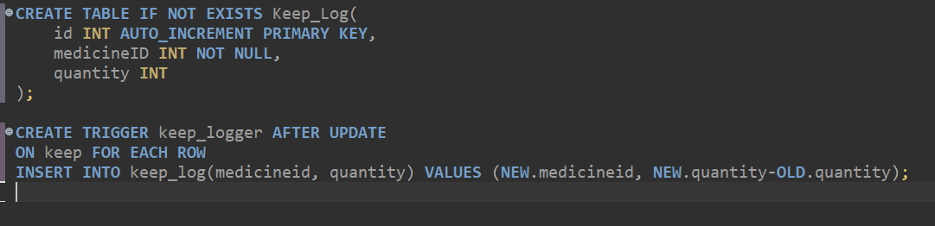
© 2023 Futurense Technologies Private Limited. All rights reserved.

Slide 24
Highlights:
Using conditional aggregation (COUNT with IF).
Incorporating common table expressions (WITH clauses) for intermediate results.
Using window functions.
Using AFTER UPDATE trigger to capture data changes.
Defining and using a stored function (CREATE FUNCTION) for custom logic.
Implementing error handling using SIGNAL SQLSTATE to raise custom errors.
Utilizing conditional aggregation with GROUP BY and ROLLUP for hierarchical summary.
© 2023 Futurense Technologies Private Limited. All rights reserved.

Slide 25
Optimizations and Best Practices Used:
Employing common table expressions (WITH clauses) to create temporary result sets, reducing repetitive table accesses.
Employing INNER JOINs for JOIN operations, which can be faster than using other types of joins when you're interested in records that exist in both tables.
Utilizing error handling with SIGNAL SQLSTATE to provide clear and informative error messages, aiding in debugging.
Utilizing conditional aggregation with ROLLUP to calculate subtotals and totals in a single pass, reducing the need for separate queries.
Utilizing dense ranking to efficiently assign ranks to insurance plans based on their counts.
© 2023 Futurense Technologies Private Limited. All rights reserved.

Slide 26
Roadblocks & Resolutions
Faced a bit of a challenge in interpreting stakeholder’s requirements.
Started implementing different approaches and compared result with each other.
Creating 2 separate count columns on different criteria.
Made use of count if nesting, which made the query faster and more compact.
© 2023 Futurense Technologies Private Limited. All rights reserved.

Slide 27
Future Scope:
Queries can be much faster, if we de-normalize the tables, as lot of joins needs to be done for pulling simple data.
Solutions provided have plenty of room for improvement.
For each problem statement there are still many new angles to think about.
© 2023 Futurense Technologies Private Limited. All rights reserved.

Slide 28
Project Resources
SQL-Project-Healthcare

Slide 29
Thank You
© 2023 Futurense Technologies Private Limited. All rights reserved.

Slide 30














© 2023 Futurense Technologies Private Limited. All rights reserved.

